Slide 1
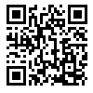
Update
Week of 04/07-11/2024

Slide 2
Previous Work
Matplotlib GUI
Rendering agents
Follow a linear path
Communication quality
Jamming area definition
A defined circle
Detect when jammed
Make a presentable, visual simulation
Interact with the llm in some way
Try to get meaningful feedback from llm in real time

Slide 3
Current Work
Pyqt5 GUI (enhanced)
Fix “when jammed” logic
Basic chat interface
Start implementing RAG
Identify how user and agents can be operating in the same context window.
Better understanding of data management

Slide 4
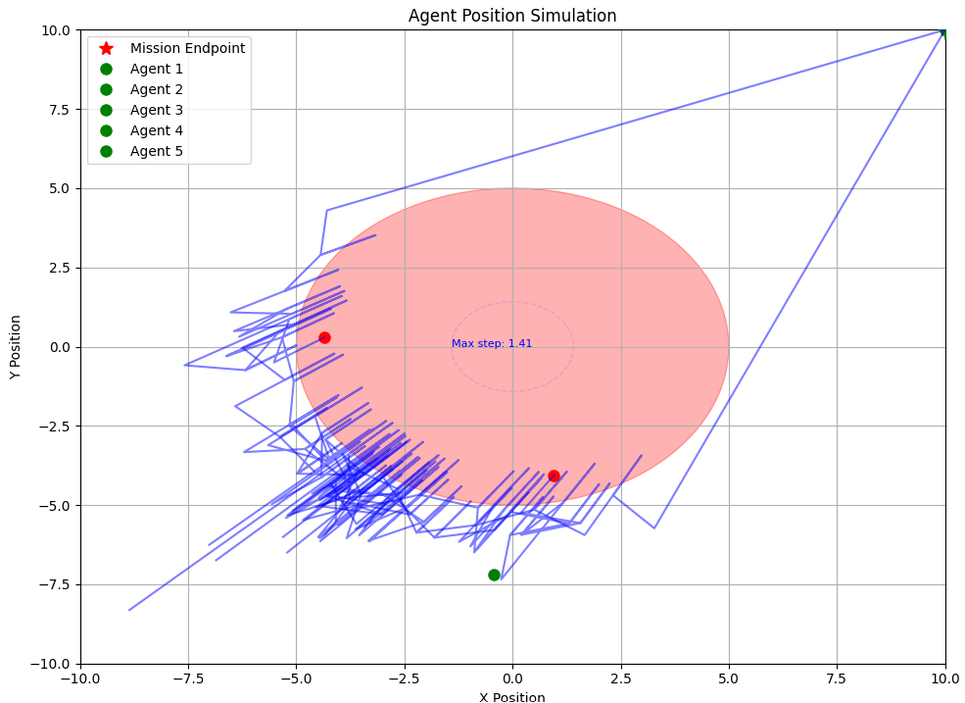
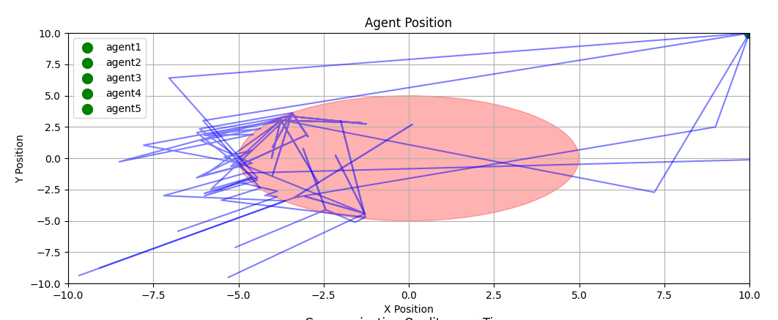

Slide 5
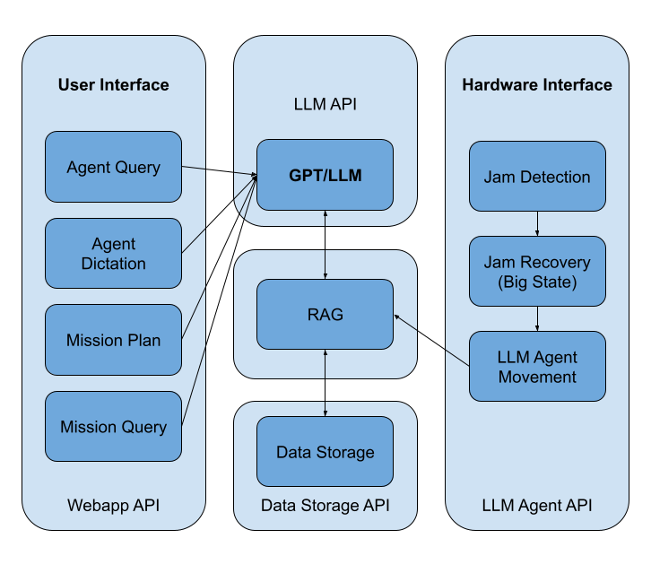

Slide 6
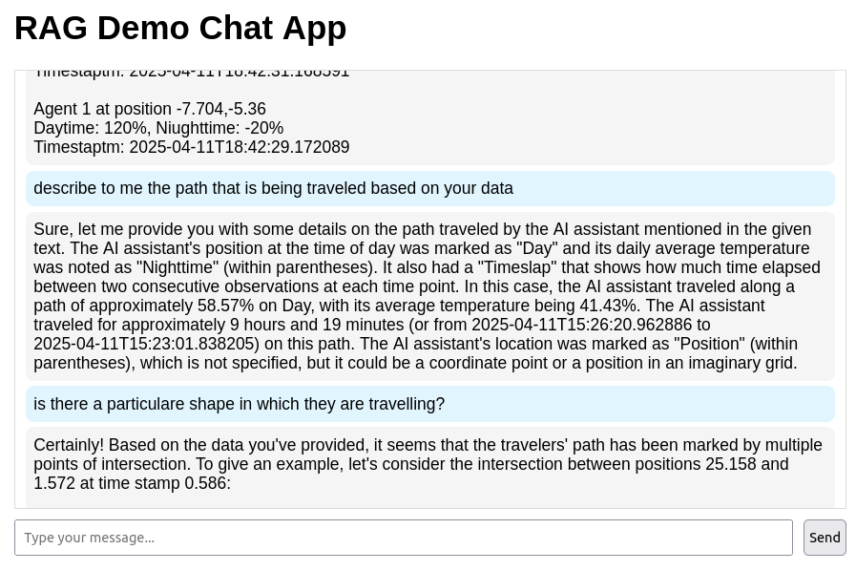

Slide 7
Future Work
Fully Functional, more applicable RAG implementation

